Slide 1


Using Machine Learning to forecast food insecurity in Yemen and Syria
ISI-WFP
Pietro Foini, Elisa Omodei, Daniela Paolotti, Michele Tizzoni

Slide 2

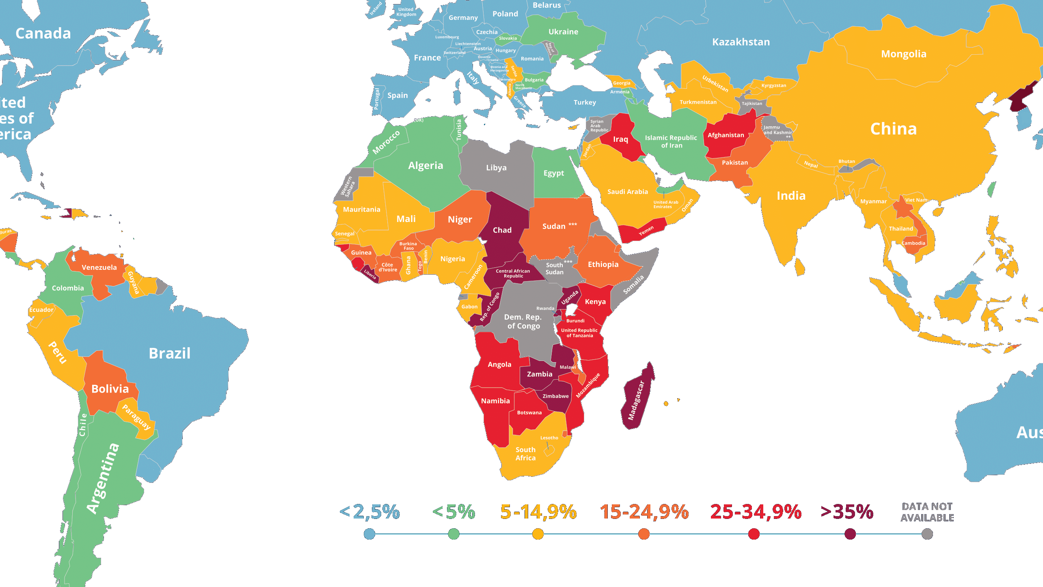
Introduction
food insecurity
the state of being without reliable access to a sufficient quantity of affordable, nutritious food.
In 2019 alone, more than 135 milion people across 55 countries faced crisis levels of acute food insecurity.
!

Slide 3





The World Food Programme (WFP) is the food-assistance branch of the United Nations (ONU) and the leading humanitarian organization saving lives and changing lives, delivering food assistance in emergencies and working with communities to improve nutrition and build resilience.
Nobel Peace Prize 2020!
Some numbers:
Assistance to 97 million people in 88 countries in 2019;
On any given day, WFP has 5,600 trucks, 30 ships and nearly 100 planes on the move, delivering food and other assistance to those in most need;
Every year, WFP distribute more than 15 billion rations at an estimated average cost per ration of US$ 0.61.
WFP and ISI Foundation are joining forces to offer a solution able to better plan and prepare for emerging food security crises.

Slide 4

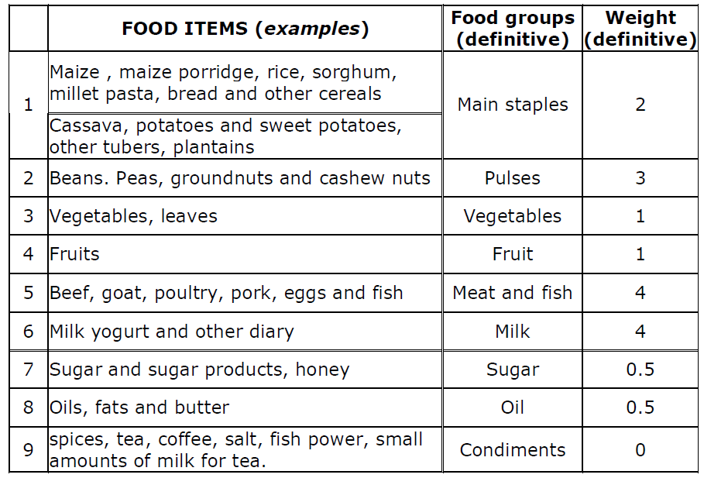
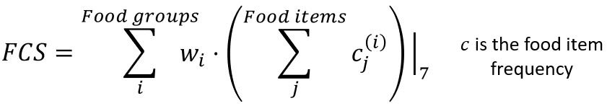
The collaboration with Elisa Omodei, data scientist at WFP, made it possible to analyze data that represented or caused food insecurity.
WFP uses food consumption as the entry point for describing food insecurity.
How in practice?
“Could you please tell me how many days in the past week your household has eaten the following foods?”
dietary diversity;
food frequency;
relative nutritional importance.
At household level
poor
borderline
acceptable
FCS < 21
21 < FCS < 35
FCS > 35

Slide 5
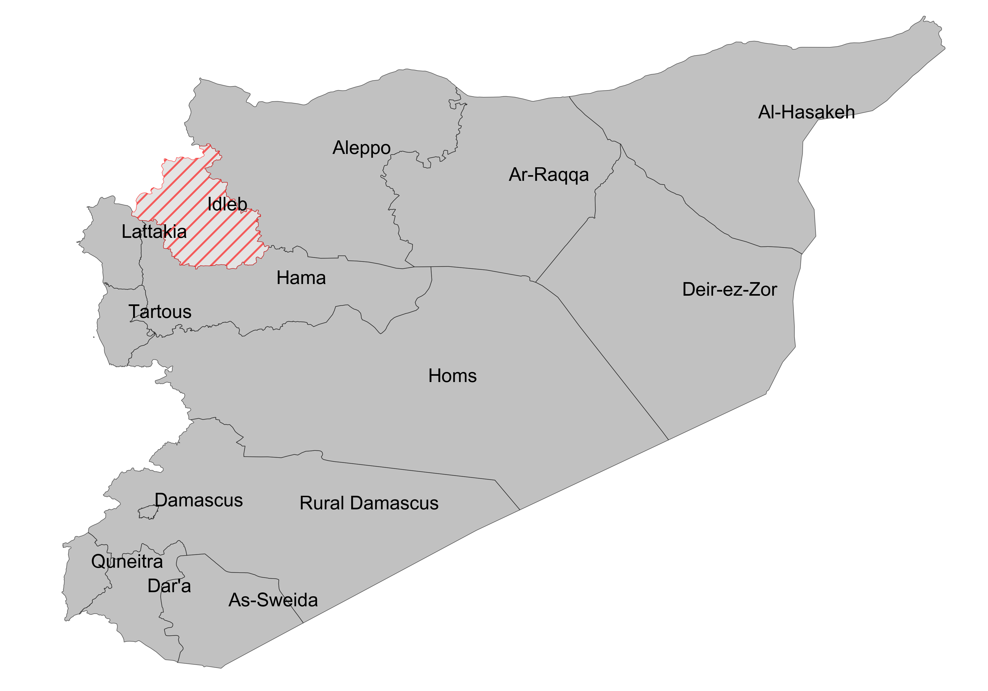
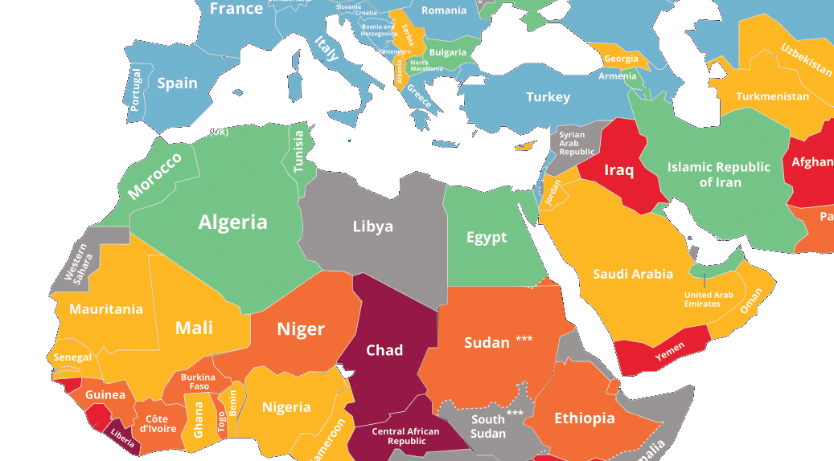
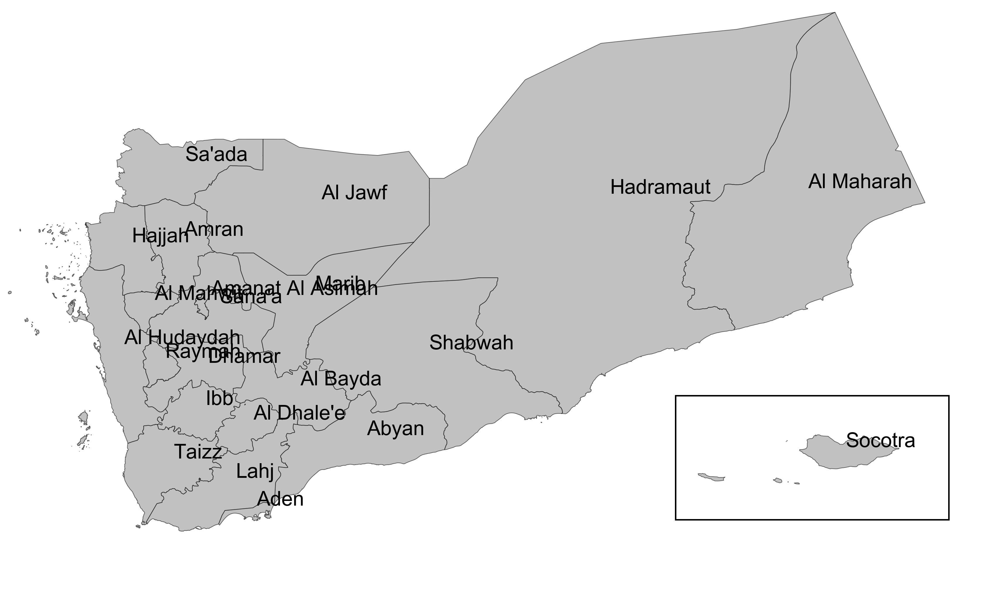
The provided data refer to two countries: Syria and Yemen.
In each of these countries, the surveys are conducted at provincial level.

Slide 6
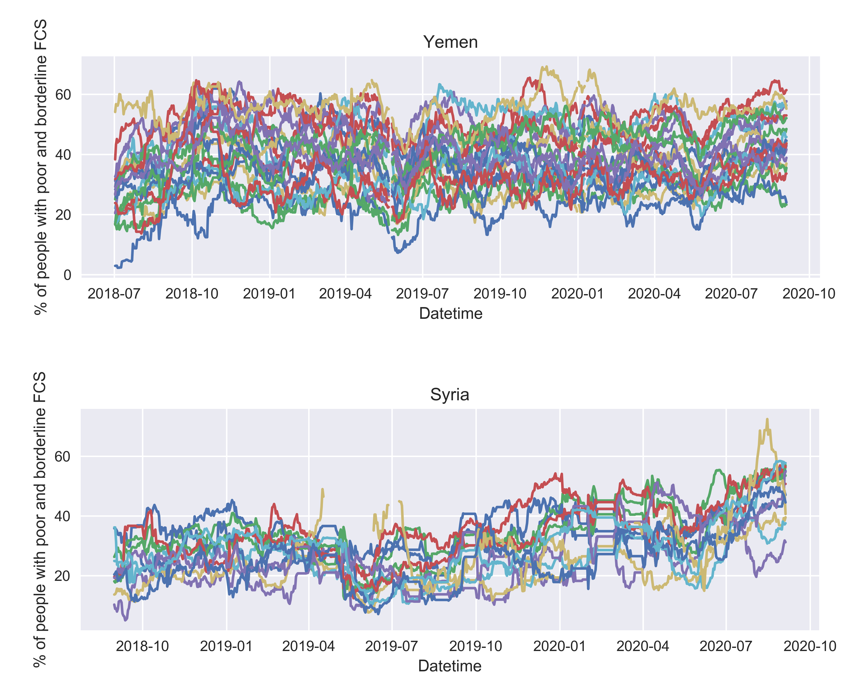
WFP’s massive data collection
Since 2018, WFP makes more than 150 daily calls interview to the households of each country.
The percentage of households within the poor and borderline classes is calculated every day for each province.
Temporal evolution of food insecurity!

Slide 7
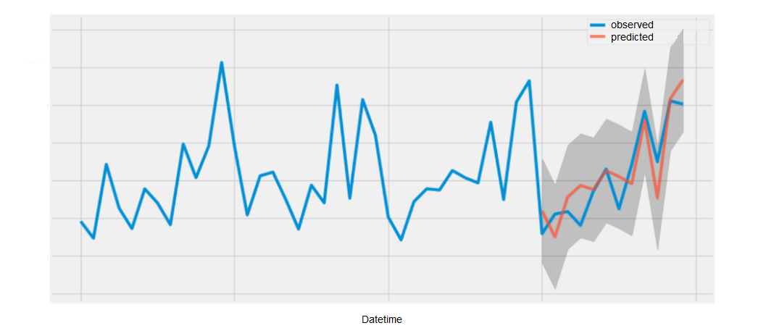
How can we help WFP in preventing food insecurity?
We are implementing a machine learning model that forecasts food insecurity trends in order to allow WFP to make timely decisions
Forecast 30 days ahead in the future of the
FCS time-series
30 days

Slide 8
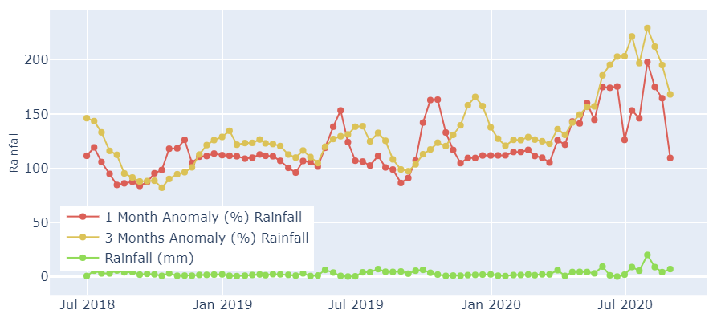
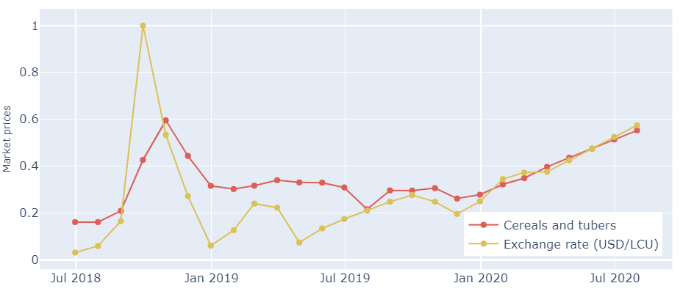
WFP has been constantly monitoring the evolution of different events that researchers identify to affect food insecurity: market prices, conflicts, precipitation, vegetation, etc.
Price of cereals and tubers (1 point each month)^{[1]};
Exchange rate (1 point each month)^{[1]};
Rainfall anomaly (3 points each month)^{[2]};
NDVI anomaly (3 points each month)^{[2]};
Fatality (daily granularity)^{[3]};
Rainfall (3 points each month)^{[2]};
Additional information can help us
Yemen - Abyan
Yemen - Abyan
[1]. https://data.humdata.org/
[2]. https://dataviz.vam.wfp.org/seasonal_explorer/rainfall_vegetation/visualizations#
[3]. https://acleddata.com/data-export-tool/

Slide 9
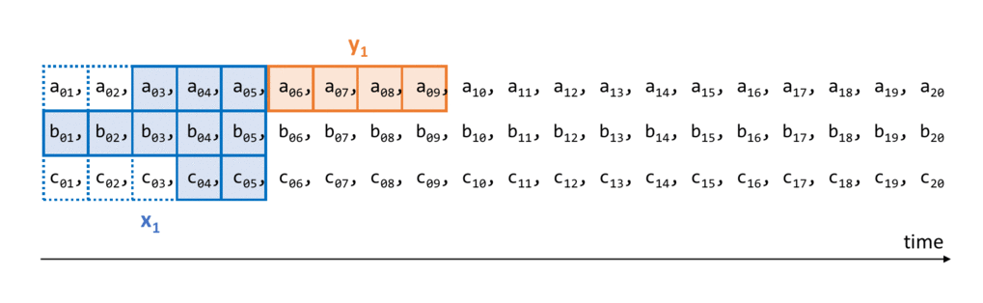
Model
XGBoost: a decision-tree-based ensemble Machine Learning algorithm that can be used for forecasting the evolution of events.
How to train the model to forecast the future?
The model tries to understand how the past influences the near future from the current history.
Today
Event to predict (FCS):
Additional information:
Additional information:

Slide 10

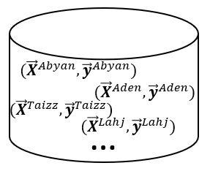

We train the model to learn the food insecurity histories of the provinces of Yemen and Syria countries:
XGBoost
Data
Trained XGBoost
Finally, we can predict 30 days ahead in the future!

Slide 11
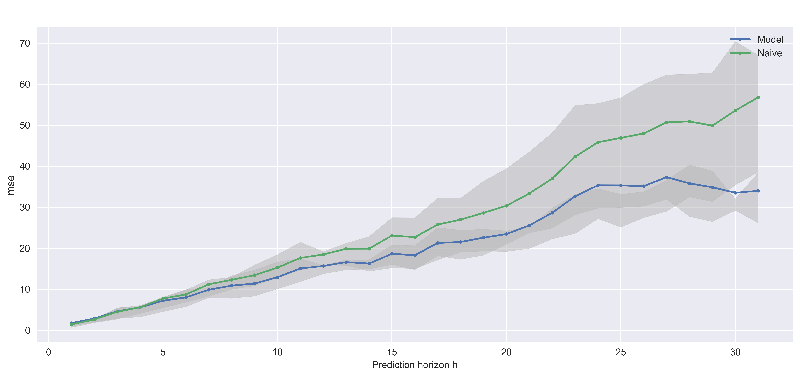
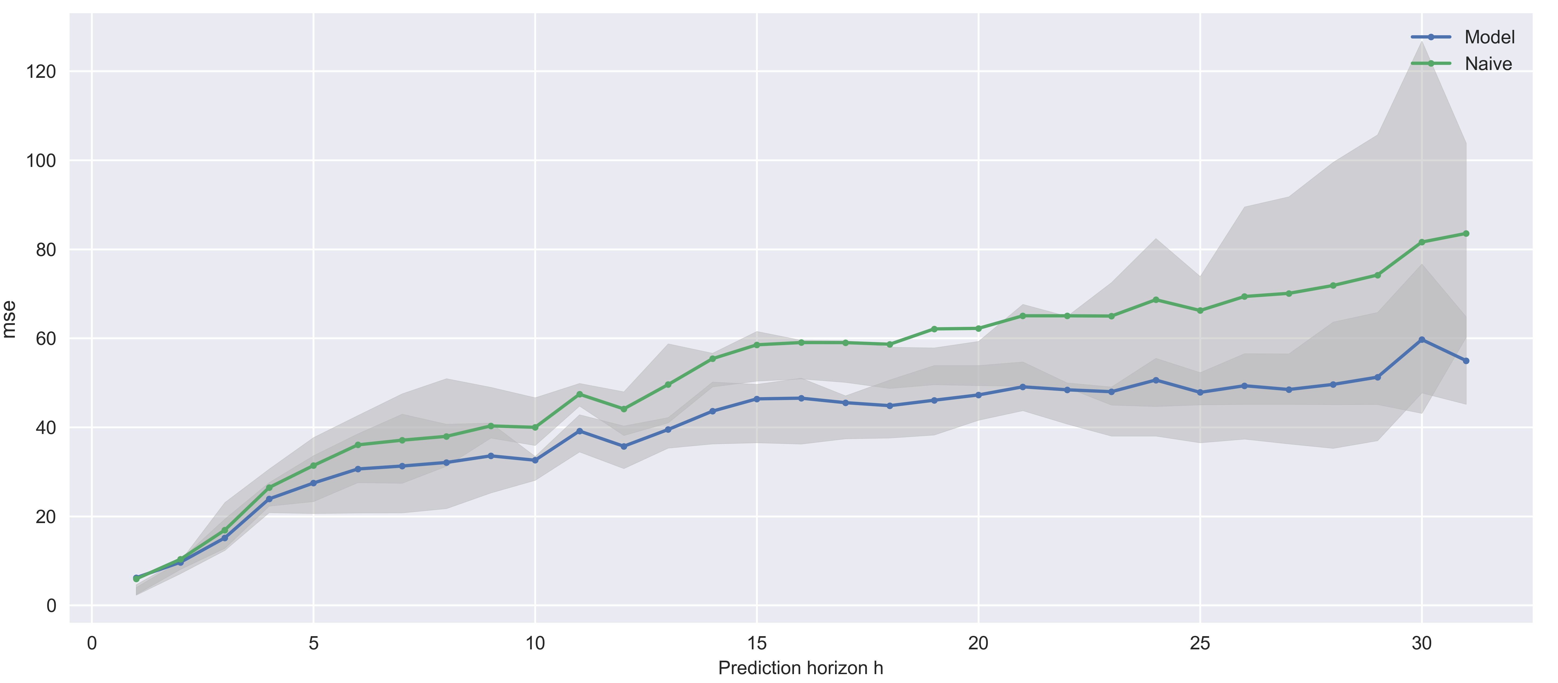
Results
We compute the overall loss (mean squared error) over all the provinces:
 | Model | Naive
Syria | 39.65 | 51.54
Yemen | 19.99 | 26.05
Yemen
Syria

Slide 12
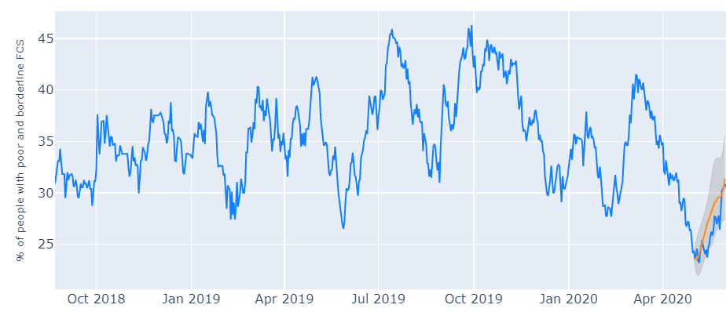
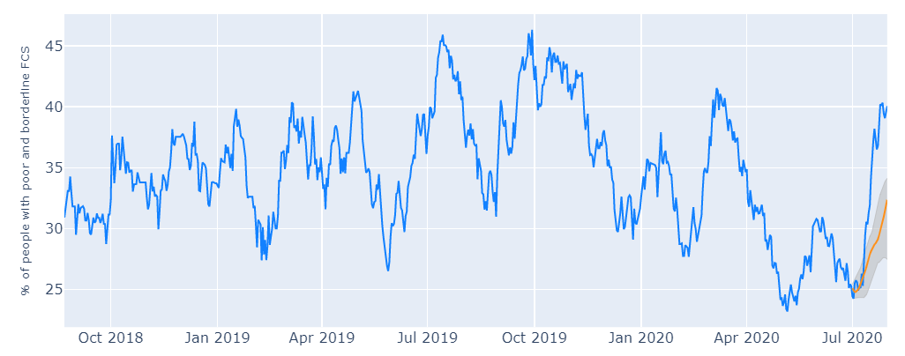
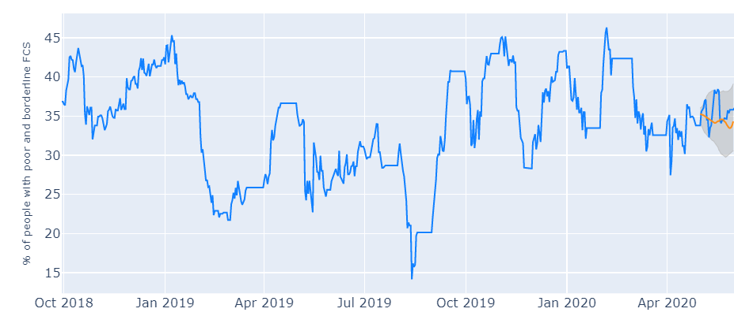
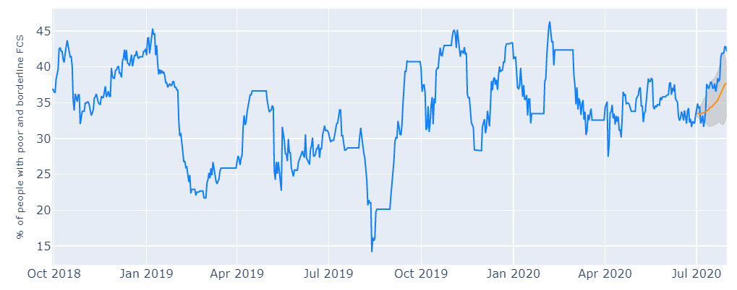
Some predictions:
Yemen - Sana’a
Yemen - Sana’a
Syria - Al-Hasakeh
Syria - Al-Hasakeh

Slide 13
Conclusions
The impact of 30 days prediction in the monitored provinces would be remarkable for WFP. Our work aims to improve model performance to provide WFP with a tool that can be implemented for a real application. Another goal is to publish a scientific article that can explain the methodology used.
The complexity of the data and of the phenomenon itself makes the implementation non-trivial but the performances obtained so far are promising. Many approaches have been tested before select the current model.
The constant update of new data is expected to lead to better predictions and to extend our approach also for those countries for which there is not yet enough data.

Slide 14




Acknowledgments
Contacts:
pietro.foini1@gmail.com
elisa.omodei@wfp.org
daniela.paolotti@isi.it
michele.tizzoni@isi.it

